Slide 1
Overview of the U.S. Equal Employment Opportunity Commission
Presented by:
Alexa Moore, Federal Investigator

Slide 2
Training Objectives
Learn about laws enforced by the EEOC and the agency’s jurisdiction
Learn about the EEOC’s priority topics to better identify such issues in your communities
Brief overview of general best practices for employers

Slide 3
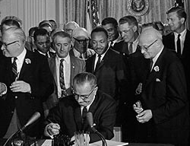
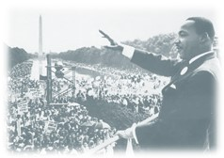
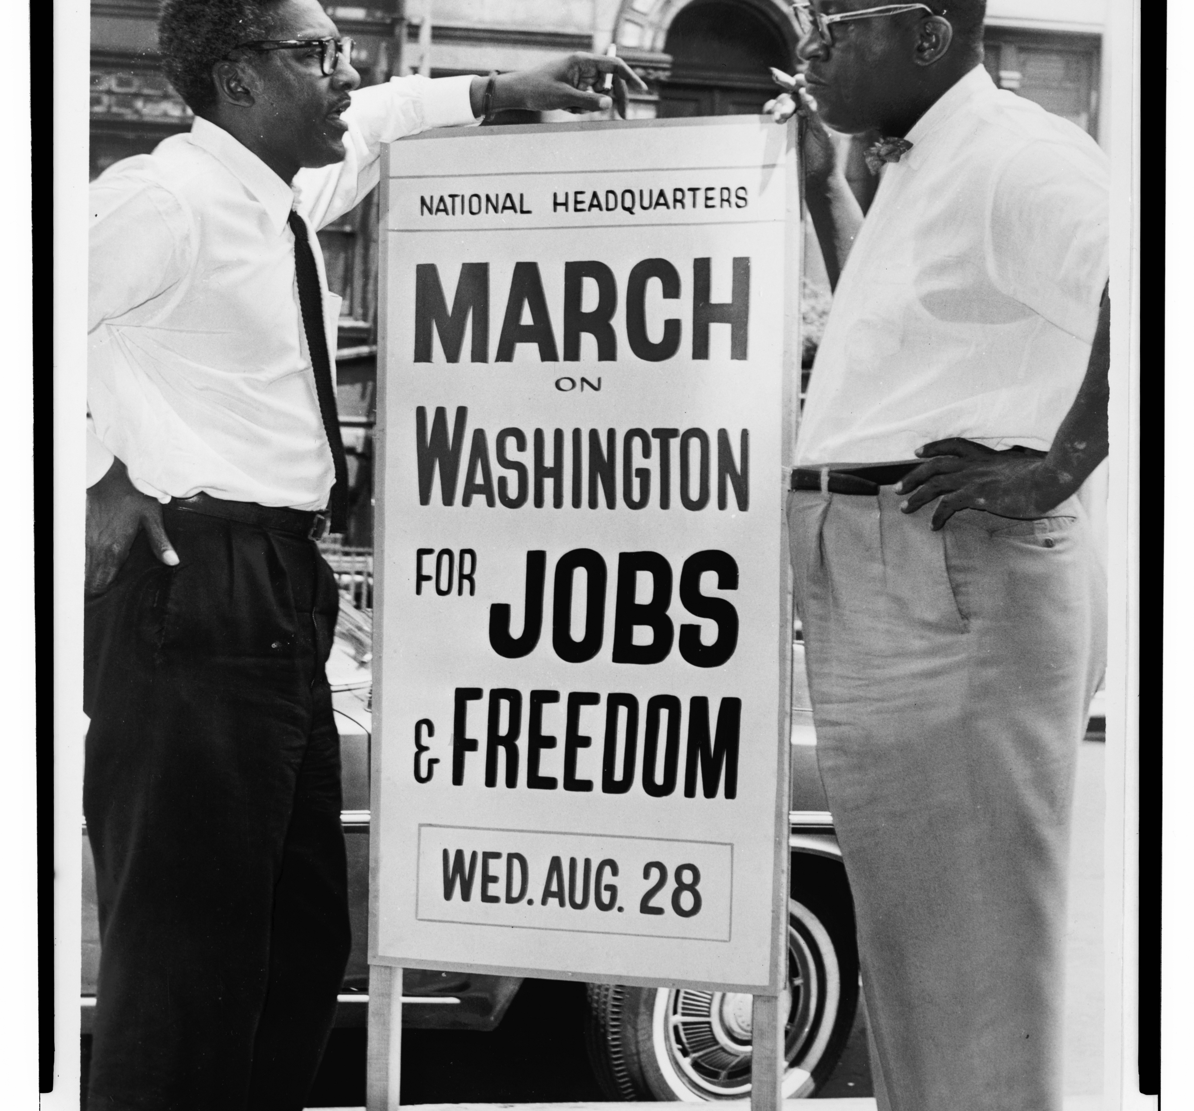
U.S. Equal Employment Opportunity Commission
Bipartisan Commission
Created over 50 years ago as part of the Civil Rights Act of 1964
Law enforcement agency
Investigations, mediations and litigation
Workshare agreement with state and tribal civil rights agencies

Slide 4
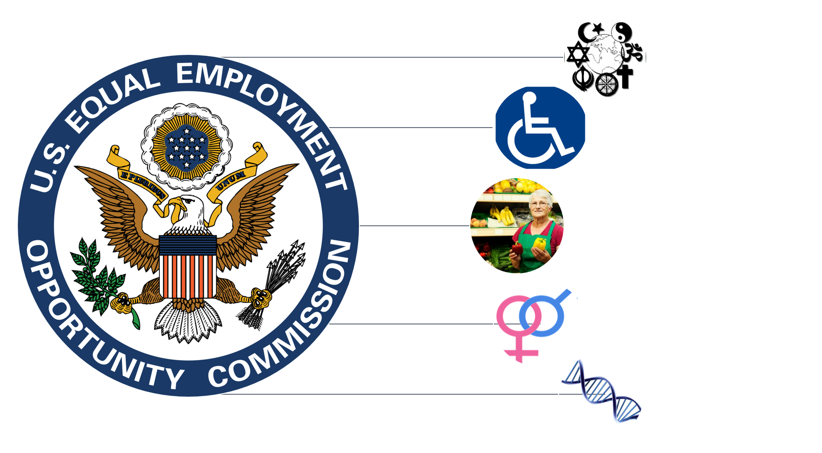
Title VII Of the Civil Rights Act of 1964
Americans with Disabilities Act of 1990, amended 2008
Age Discrimination in Employment Act of 1967
Equal Pay Act of 1963
Genetic Information Non-Discrimination in Employment Act of 2008

Slide 5
EEOC Jurisdiction
Title VII of the Civil Rights Act of 1964
Race, color, national origin, religion, sex (pregnancy, sexual orientation, gender identity)
Americans with Disabilities Act of 1990, amended 2008
Disability (actual, perceived as, and history of)
Age Discrimination in Employment Act of 1967
Age 40 years or older
Equal Pay Act of 1963
Wage discrimination because of sex
Genetic Information Non-Discrimination Act of 2008
Acquisition of or discrimination due to genetic information

Slide 6
Federal v. State Law
U.S. EEOC
MI MDCR
Ancestry
Marital Status
Medical Condition
Military or Veteran Status
Race
Color
Religion
Sex (including pregnancy, gender identity, and sexual orientation)
National Origin
Age (>40 years)
Disability
Genetic Information
All of the previous groups, plus

Slide 7
Who is covered?
Employees
Job applicants
Former employees
Applicants or participates in a training or apprenticeship program
Business/private employers
State or local governments
Federal government agencies
Employment agencies
Labor unions or join apprenticeship committees
Employers must have 15+ employees to be covered by EEOC jurisdiction.
*except the EPA

Slide 8
Statute of Limitations
Most EEOC Offices: 300 days from the date of harm
State Agencies: 180 days from the date of harm

Slide 9
What is discrimination?
Adverse employment action due to an applicant or employee’s protected status or for engaging in a protected activity:
Discipline
Termination
Wage disparity
Denied a reasonable accommodation
Harassment
Constructive discharge
Protected activity:
Filing an internal complaint
Filing a charge with the EEOC or MDCR
Participating in an investigation as a witness

Slide 10
Disparate Treatment vs. Adverse Impact
Disparate Treatment
Employee or applicant treated adversely because of their protected class
Discriminatory motivation need not be conscious
Adverse Impact
Focus is on whether a policy has discriminatory effects that cannot be legally justified
Facially neutral policy or practice has a substantially greater negative impact on members of a protected class

Slide 11
Elements of Harassment
Protected Basis
+
Tangible Employment Action
OR
Hostile Work Environment
+
Liability
= Illegal Harassment

Slide 12
Harassment is Significantly Underreported

Slide 13
Reasonable Accommodation

Slide 14
Reasonable Accommodation Under the ADA
Disability: physical or mental impairment which substantially limits one or more major life activities
Covers:
Individuals with a disability
Record of disability
Request can be verbal or in writing
Interactive process
Employer may request additional medical documentation if accommodation request needs clarification
Discussion
May be more than one effective accommodation option
Leave may be considered as a reasonable accommodation
Reasonable accommodation must be absent an undue hardship for the employer

Slide 15
Retaliation
Employers cannot take an adverse action against an individual for engaging in a “protected activity”
filing a charge of discrimination
participating in a discrimination proceeding
otherwise opposing discrimination
Complaint must indicate they believe treatment is due to a protected status
Adverse action could create a “chilling effect”
Must be a connection between the protected activity and the adverse action

Slide 17
Strategic Enforcement Plan 2017-2021
Eliminating
Eliminating barriers in recruitment and hiring
Enforcing
Enforcing equal pay laws
Protecting
Protecting immigrant, migrant and other vulnerable workers
Addressing
Addressing emerging and developing issues
Preserving
Preserving access to the legal system

Slide 18
Best Practices
Implement a strong EEO policy embraced at the top levels of the organization.
Train managers, supervisors and employees; enforce policy; and hold them accountable.
Provide clear assurance that employees who make complaints or provide related information will be protected against retaliation
Promote inclusive culture in the workplace by fostering an environment of professionalism and respect for personal differences.
Foster open communication and early dispute resolution.
Document, document, document!

Slide 19
Contact the EEOC!
www.eeoc.gov
Detroit Field Office:
(313) 226-4600
Lolita Davis, Outreach & Education Coordinator:
(313) 226-3783
Alexa Moore, Federal Investigator:
(313) 226-4626 or alexa.moore@eeoc.gov

