Slide 1
Reducing O.P.E.B. Liability
TOOLS to insure you can pay for your health insurance promises

Slide 2
Northville’s experience

Slide 3
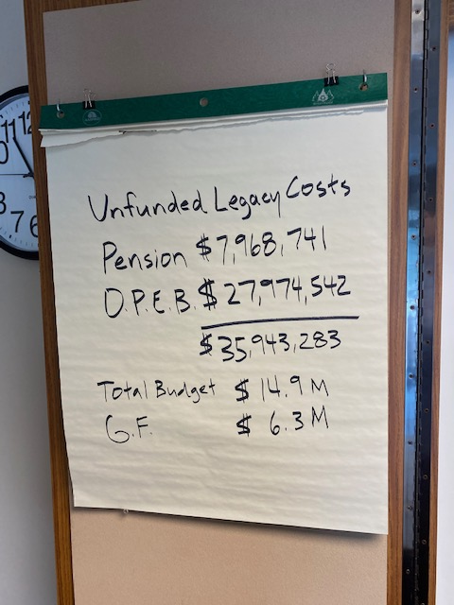
Set the Stage
“we’re in this together”

Slide 4
TOOLS in the Toolbox
Extra Contributions
Generous Opt – Out Program
“Trenton” Clause
Two Tiering
Check the Math
Cost Sharing
Plan Design (Find a great agent of record!)

Slide 5
Generous Opt–Out Program
Payment – 50% of City share of premium – capped at $650/month
25% of actives and 47% of retirees elect to take opt-out payment

Slide 6
Trenton Clause (2004)
“The level of future medical or prescription drug insurance coverage for pre-Medicare retirees shall be modified to be identical to that provided to employees under subsequent collective bargaining agreements”

Slide 7
Two (or three) Tiering (2008)
Retiree health insurance eliminated for employees hired after 2008
Replace with Health Care Savings Plan

Slide 8
Check the Math!!! (2012)
Check all actuarial assumptions – especially projected premiums for retirees
When we corrected our report with accurate retiree premiums, we reduced our unfunded liability by $9.8 million (26%)

Slide 9
Cost Sharing (2013)
City opted 80/20 cost share (actives only) to comply with EVIP HCSP Contribution - Single: $,2,400 2P/Family: $4,800
“Trenton” Clause – Retirees get same coverage as active employees
“Skin in the game” – employee paying 20% makes it easier to negotiate changes
Right to transfer employees to “substantially equal coverage.”

Slide 10
Plan Design
United American-Medicare Supplement (2013)
  Blue Cross $1,148.22 single $2,296.44 2 person
  United American $386.21 single $772.42 2 person
  Reduced annual premium by 66% $270,000
  Reduced OPEB Liability by $3.2 million – 8.5% of total liability

Slide 11
Plan Design – No “Frills” (2017)
Replaced Retiree Dental coverage with one-time Stipend
Less than 15 years of service - $3,000 in H.C.S.P.
15 years or more - $5,000
Eliminated Prescription Drug (Part B) Reimbursement
“Give and Take” improved optical benefit with slightly higher premium

Slide 12
Extra Contributions
Year | Contribution
2013 | $292,494
2014 | $309,007
2015 | $121,095
2016 | $116,387
2017 | $193,685
2018 | $455,503
2019 | $501,210
2020 | $349,314
 | $2,338,695

Slide 13
Northville’s experience

