Slide 1
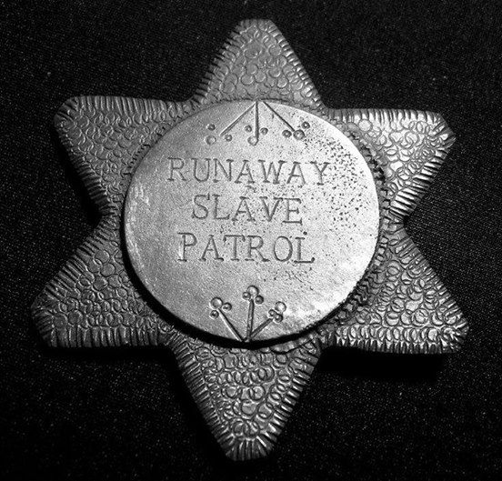
SYSTEMIC RACISM IN POLICING HISTORY
1704 – South Carolina – Slave Patrol Established
The slave patrols' function was to police enslaved persons, especially runaways and who was view as defiant. They also formed river patrols to prevent escape by boat. Slave patrols were first established in South Carolina in 1704, and the idea spread throughout the colonies.

Slide 2
SYSTEMIC RACISM IN POICING HISTORY
1893 – Detroit – First Black Police Officer
The Detroit Police Department embraced innovation and change in the late 19th and early 20th centuries. In 1893, L.T. Toliver became the city’s first African American police officer.

Slide 3
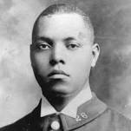
SYSTEMIC RACISM IN POLICING HISTORY
1911 – New York City – First Black Police Officer
Samuel Jesse Battle was the first black police officer in New York City. After attending segregated schools in North Carolina, Battle moved north, first to Connecticut, then to New York City, where he took a job as a train porter and began studying for the New York City Police Department civil service exam.

Slide 4
SYSTEMIC RACISM IN POLICING HISTORY
1886 – Washington, D.C. – First Black Police Officers
The first Black- American Police Officers with the MPDC were Charles Tillman and Calvin Caruthers.

Slide 5
RACISM IN LAW ENFORCMENT HISTORY
DC Police History
1965- The FIRST Black-American Captain with the MPDC is Owen Davis. Davis was also the first Black American to be assigned his own precinct to run. 1969 - Owen Davis becomes a Deputy Chief 1978 - The FIRST Black-American Chief of Police with the MPDC is Burtell Jefferson

Slide 6
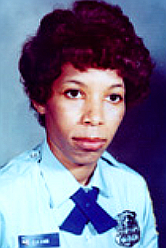
SYSTEMIC RACISM IN POLICING HISTORY
1774 – Washington, D.C. – First Female Black Police Officer
First female police officer in the United States shot and killed while patrolling in the line of duty.

Slide 7
SYSTEMIC RACISM IN POLICING HISTORY
DC Police Today
Established 1861 (Pre-Civil War)
3,800 Sworn
34% White
51% African American
15% Asian/Latino/Other
77% Male
23% Female

Slide 8
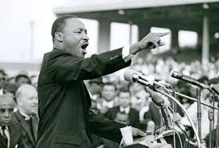
SYSTEMIC RACISM IN POLICING THE NATION TODAY
In urban areas, police are consistently much whiter than the people they serve
Washington Post – June 4, 2020

Slide 9
SYSTEMIC RACISM IN POLICING HOW TO ADDRESS BIAS AND RACISM
Recruiting/Hiring/Leadership
DC Police Special Liaison Branch (Kevin)
Cadet Program
LISTEN!!!! "A riot is the language of the unheard."
Rev. Dr. Martin Lutcher King, Jr.

