Slide 1

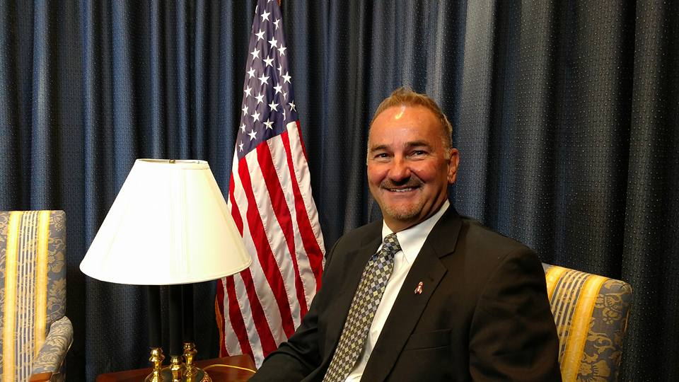


The EMS System of the Future
Thomas Wieczorek
Retired City Manager Ionia, MI; former Executive Director CPSE, Inc.
Matt Zavadsky MS-HSA, NREMT
Senior Associate

Slide 2
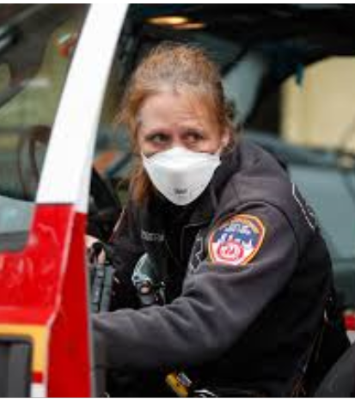
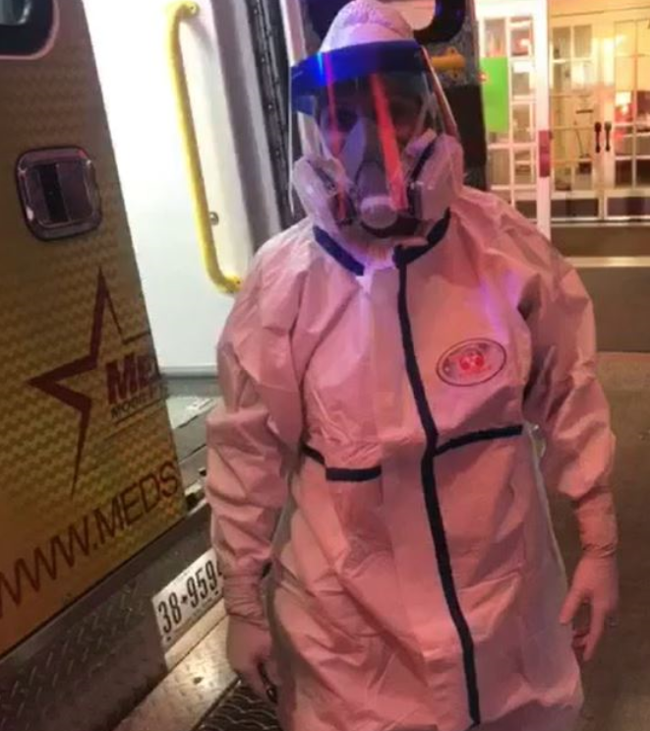

In What Ways has the Coronavirus Pandemic Changed EMS in the U.S.?
Notes:
Workforce issues, provider safety (PPE supply chain), mental/emotional stress, disrupted living environments from fear of ‘bringing it home’, response volume

Slide 3


In What Ways has the Coronavirus Pandemic Changed EMS in the U.S.?
Notes:
Recognition, appreciation for what we do on the front lines of healthcare – TIP OF THE SPEAR – “EMS’ 9/11”
In unpredictable environments, EVERY environment, no ‘back-up’, air conditioning, perfect lighting, uncontrolled situations
At least 50 EMS providers have died from line of duty COVID infection

Slide 4


In What Ways has the Coronavirus Pandemic Changed EMS in the U.S.?
Notes:
Recognition, appreciation for what we do on the front lines of healthcare – TIP OF THE SPEAR
In unpredictable environments, EVERY environment, no ‘back-up’, air conditioning, perfect lighting, uncontrolled situations

Slide 5
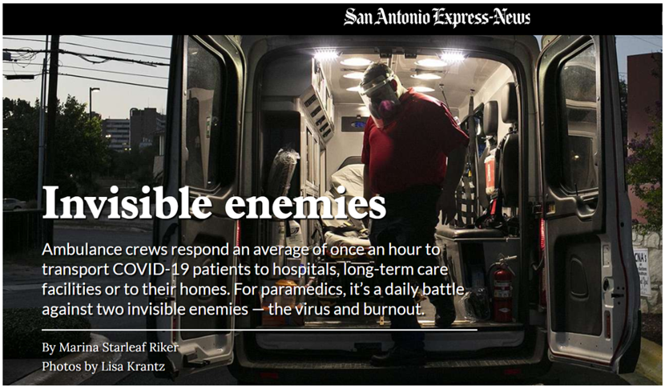
By Marina Starleaf Riker
Photos by Lisa Krantz
July 26, 2020
https://www.expressnews.com/coronavirus/article/The-closest-thing-medicine-gets-to-war-24-15427294.php
Notes:
“The closest thing medicine gets to war”

Slide 6
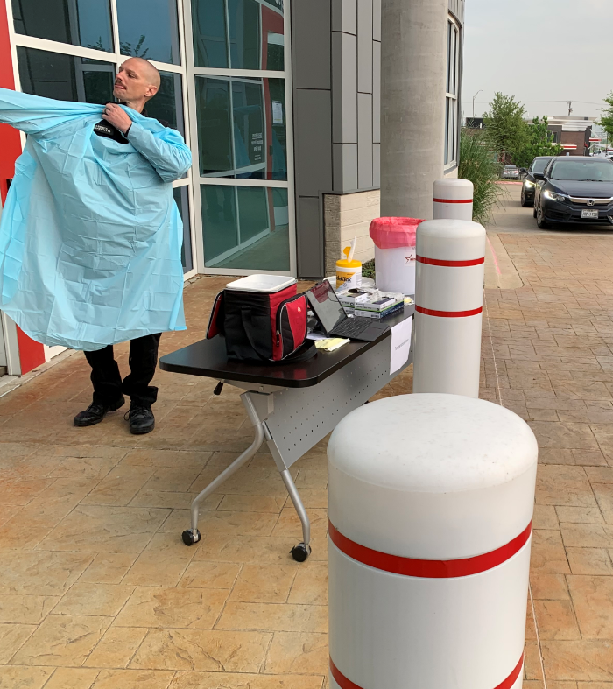
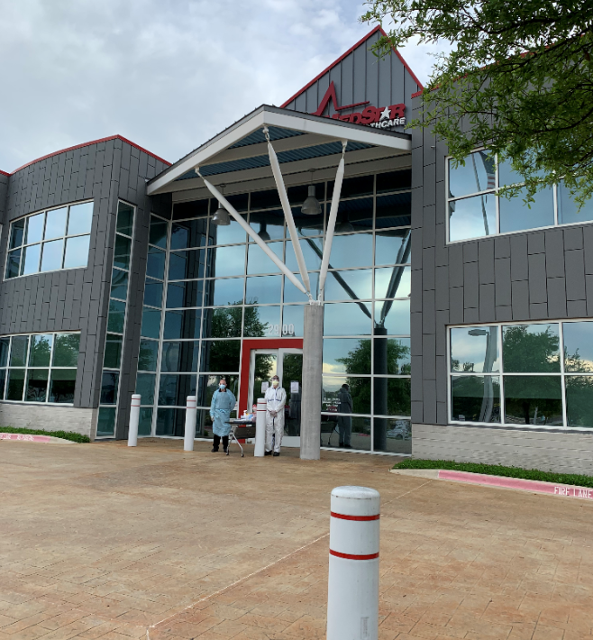
In What Ways has the Coronavirus Pandemic Changed EMS in the U.S.?
Notes:
Rapidly changing roles (patient navigation vs. transport, post discharge follow-ups, COVID testing, SNF testing/training, contact tracing)
Economic disruption (call volume, costs, workforce issues, etc.)

Slide 7
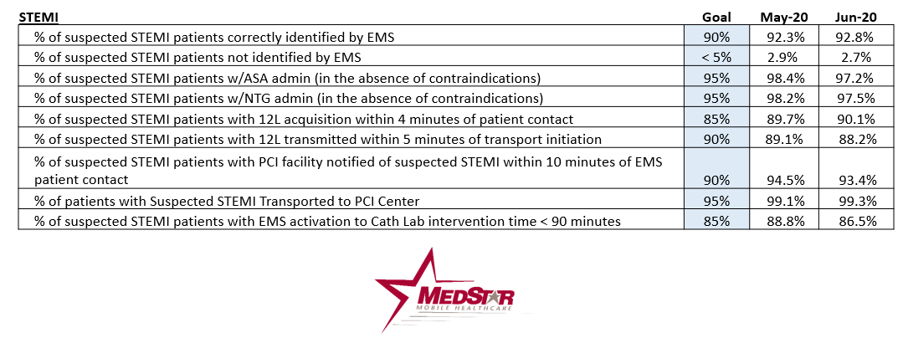
What KPIs should City/County Managers Understand Today About their EMS System?
Notes:
Fall into 4 main categories that need to be continually balanced: Clinical, Operational, Financial and Experiential
Clinical: performance bundles for heart attack, stroke, major trauma, advanced airway management (if done well, people live, if done wrong, people die), skills utilization (higher desirable)
Operational: clinically appropriate and REASONABLE response times (based on clinical ‘risk’), utilization (UHU - % of times on calls)
Financial: cost and revenue per unit hour, response and transport.
Experiential: What do the patients think about the service? What does the community think?

Slide 8
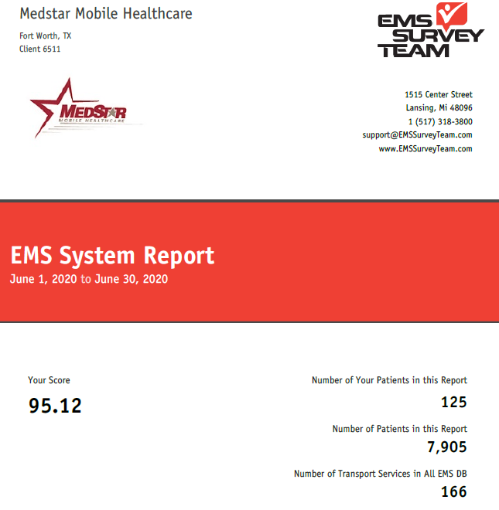
What KPIs should City/County Managers Understand Today About their EMS System?
Notes:
Fall into 4 main categories that need to be continually balanced: Clinical, Operational, Financial and Experiential
Clinical: performance bundles for heart attack, stroke, major trauma, advanced airway management (if done well, people live, if done wrong, people die), skills utilization (higher desirable)
Operational: clinically appropriate and REASONABLE response times (based on clinical ‘risk’), utilization (UHU - % of times on calls)
Financial: cost and revenue per unit hour, response and transport.
Experiential: What do the patients think about the service? What does the community think?

Slide 9
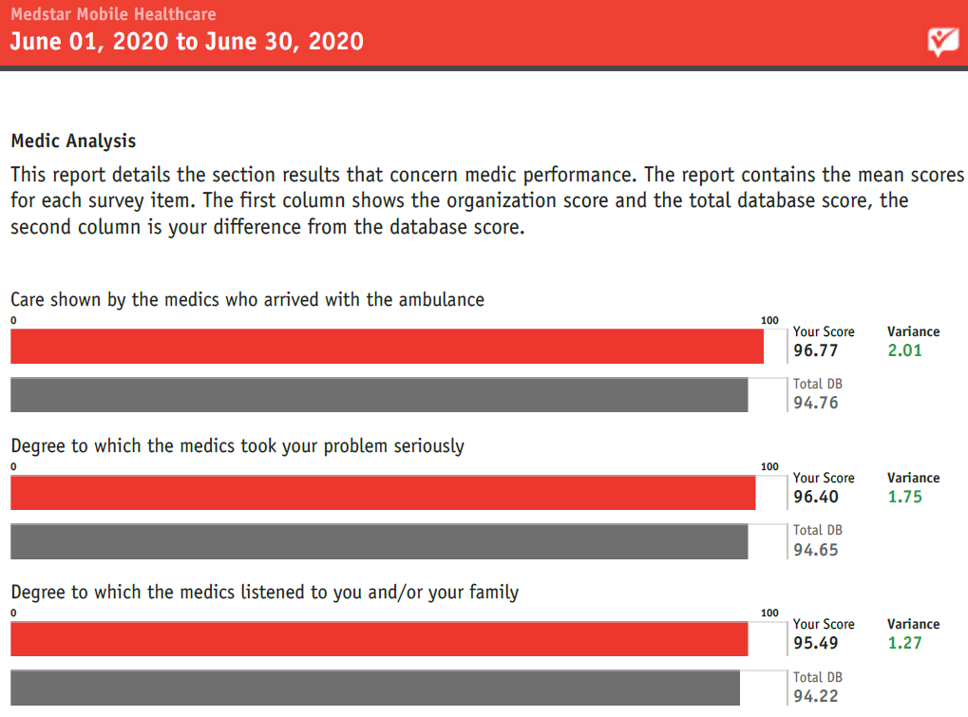
What KPIs should City/County Managers Understand Today About their EMS System?
Notes:
Fall into 4 main categories that need to be continually balanced: Clinical, Operational, Financial and Experiential
Clinical: performance bundles for heart attack, stroke, major trauma, advanced airway management (if done well, people live, if done wrong, people die), skills utilization (higher desirable)
Operational: clinically appropriate and REASONABLE response times (based on clinical ‘risk’), utilization (UHU - % of times on calls)
Financial: cost and revenue per unit hour, response and transport.
Experiential: What do the patients think about the service? What does the community think?

Slide 10

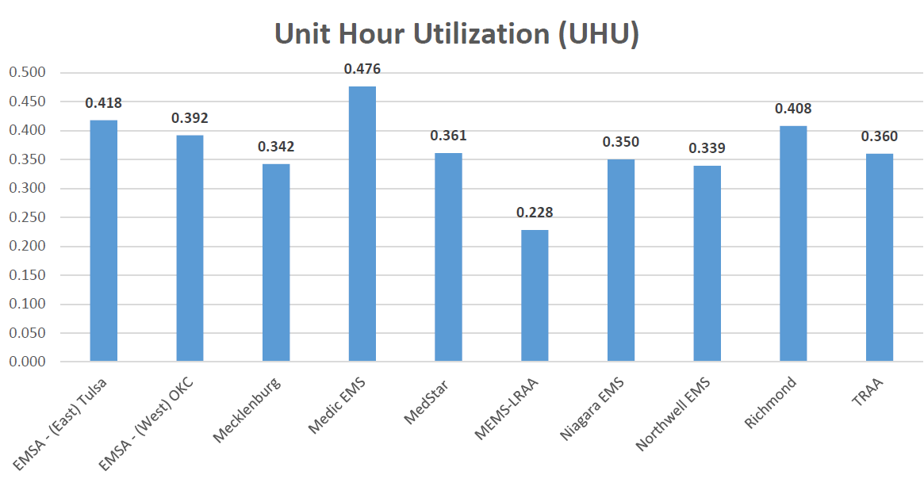
Can EMS Performance be ‘Benchmarked’?
Notes:
Absolutely. Many states do cost evaluation for some form of supplemental payments
National associations public data on KPIs
AIMHI Example
ESO example – Clinical measures
CPSM has deep resources to compare/contrast KPIs
Don’t under-estimate the value of internal benchmarking over time – look for trends

Slide 11
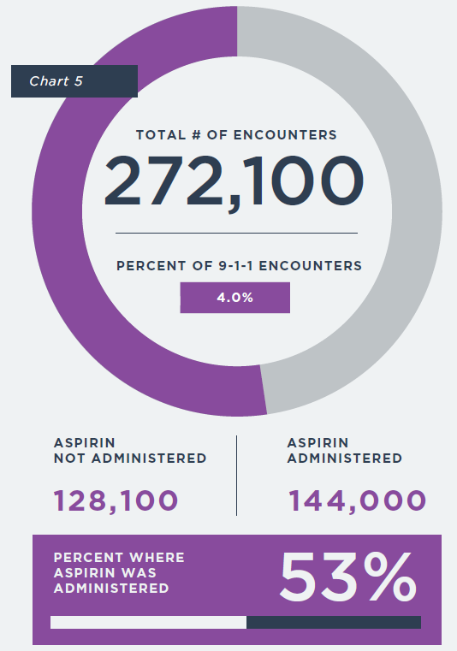
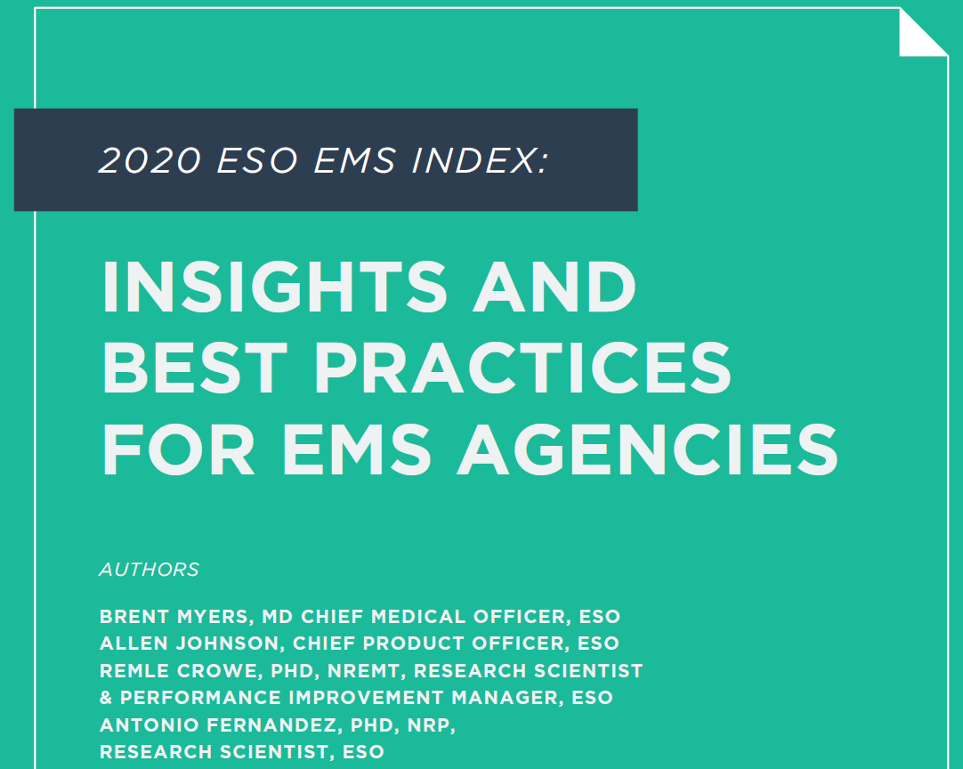
Can EMS Performance be ‘Benchmarked’?
Notes:
Absolutely. Many states do cost evaluation for some form of supplemental payments
National associations public data on KPIs
AIMHI Example
ESO example – Clinical measures
CPSM has deep resources to compare/contrast KPIs
Don’t under-estimate the value of internal benchmarking over time – look for trends

Slide 12
Can EMS Performance be ‘Benchmarked’?
Notes:
Absolutely. Many states do cost evaluation for some form of supplemental payments
National associations public data on KPIs
AIMHI Example
ESO example – Clinical measures
CPSM has deep resources to compare/contrast KPIs
Don’t under-estimate the value of internal benchmarking over time – look for trends

Slide 13
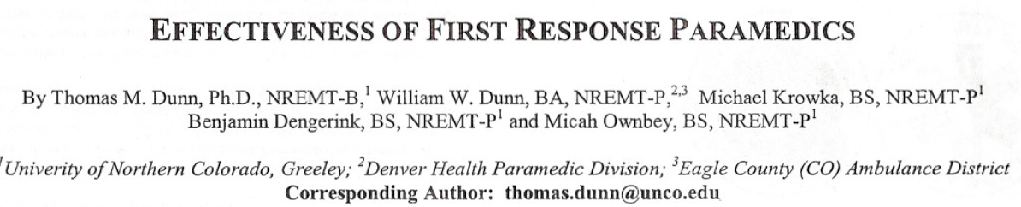
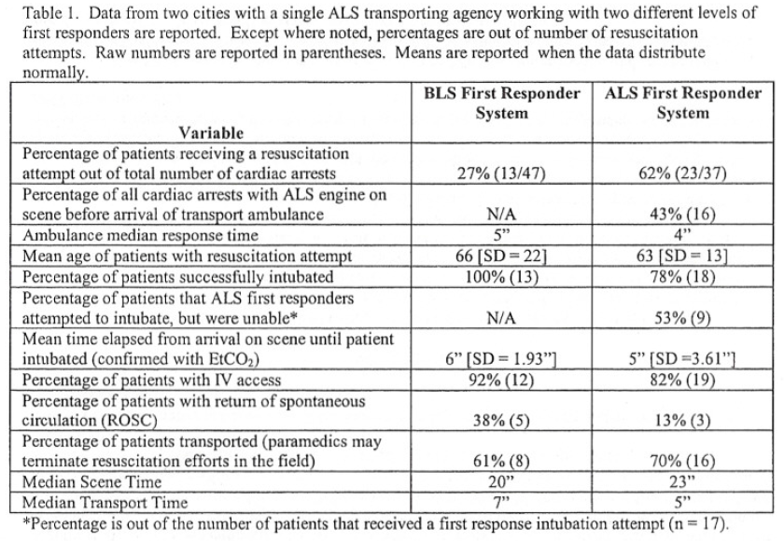
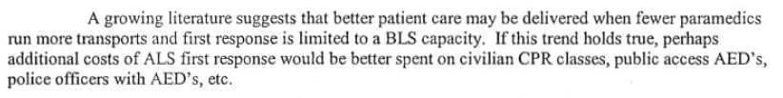
What Are the Major Factors Influencing EMS?
Notes:
Clinically:
Research and evidence is growing. EMS has a Hx of going for the newest shiny thing. As more research is conducted, we’re learning more about what matters and doesn’t matter, clinically.
The risk is that what the research is showing is leading to value questions about ‘traditional’ EMS.
Evidence is growing to support the EMS Transformation, not just hook and haul, but prevention and navigation
Economics:
Payers (insurers and taxpayers) are asking tough questions – what do we really NEED, vs. what is currently provided
What’s the true value proposition for EMS going forward – may not be in response and transport – do we really need all ALS, do we really need an 8 minute response time with 90% reliability
What can we afford? What’s the best model?
Diversity issues:
83% of Nationally Registered paramedics are white males

Slide 14
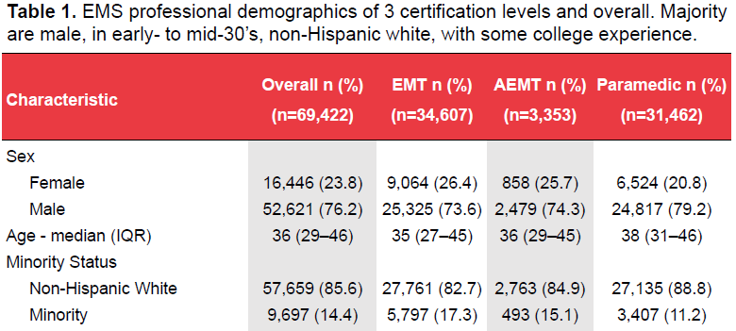
What Are the Major Factors Influencing EMS?
Notes:
Clinically:
Research and evidence is growing. EMS has a Hx of going for the newest shiny thing. As more research is conducted, we’re learning more about what matters and doesn’t matter, clinically.
The risk is that what the research is showing is leading to value questions about ‘traditional’ EMS.
Evidence is growing to support the EMS Transformation, not just hook and haul, but prevention and navigation
Economics:
Payers (insurers and taxpayers) are asking tough questions – what do we really NEED, vs. what is currently provided
What’s the true value proposition for EMS going forward – may not be in response and transport – do we really need all ALS, do we really need an 8 minute response time with 90% reliability
What can we afford? What’s the best model?
Diversity issues:
83% of Nationally Registered paramedics are white males

Slide 15
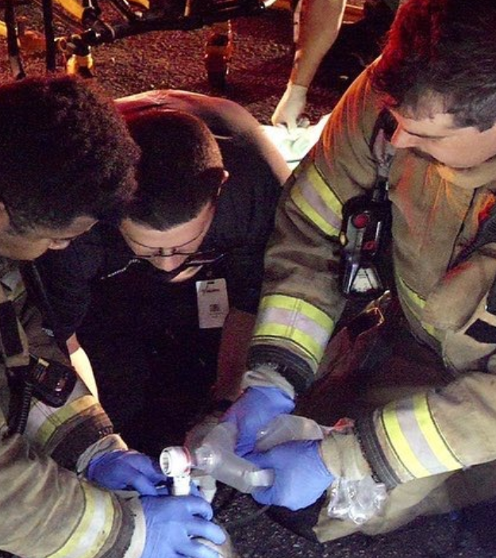

What Does EMS Look Like in 2030, 2050?
Notes:
Integral part of healthcare delivery, less ‘public safety’ role – a healthcare role
Prevention a core component (CP programs, concierge services, etc.)
Public has realistic expectations of the EMS system – based on clinical evidence/research
Determined as an “Essential Service”, but at a much different service level and type
Ineffective providers fade away, as the expectations and roles transform

Slide 16

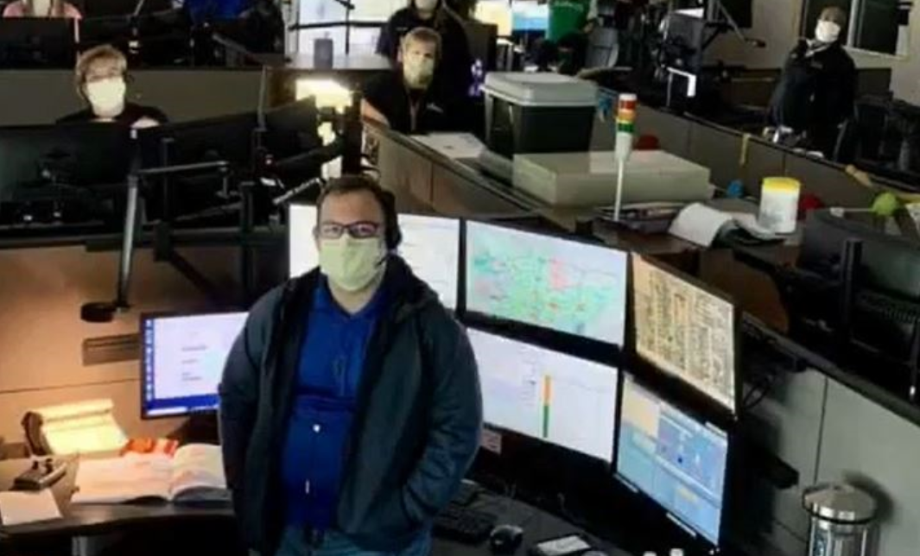
What Should City/County Leaders be Considering Today?
Notes:
Entering very difficult economic times
Start objectively evaluating the effectiveness of your system (clinically, operationally and FINANCIALLY)
Look at other models – DESIGN your system – don’t just let it evolve.
Economics is driven by service level and many EMS systems were built on the misconceptions like you need a paramedic on every call, every EMS call needs an 8 minute or less response time, more paramedics are better than fewer paramedics, etc. These are misconceptions that have almost universally been proven through research to not be true. Only about 5% of EMS responses are time/life sensitive, 95% of the calls it really doesn’t clinically matter 8 minutes vs. 30 minutes. Most EMS calls only need BLS care (and are paid for at the BLS payment level)
Engage in community conversations about desired service levels – include the medical community – what is a realistic service level and what does that cost.
Most EMS systems were NOT designed – they EVOLVED, based often on misconceptions about what clinically matters.

Slide 17
Contact Information
Thomas Wieczorek
Retired City Manager Ionia, MI; former Executive Director CPSE, Inc.
TWieczorek@cpsm.us
616-813-3782
Matt Zavadsky MS-HSA, NREMT
Senior Associate
MZavadsky@cpsm.us

